Slide 1

Project 2 - Can you hear a reservoir?
Malvin Varpe &
Torgrim Odde

Slide 2
Agenda
Introduction
Governing Equation & Transformation
Ex 1: Steady-State Solution
Ex 2: Implicit Transient Solver
Ex 3: Comparison to Line-Source Solution
Solver Performance & Scaling
Ex 4: Well test matching
Project limitations & Alternatives
Conclusions

Slide 3
Introduction
Objective: Model radial pressure in a reservoir
Project structured into 4 exercises
  Steady state solution
  Time dependent solution
  Accuracy & performance
  Well test data fitting
Notes:
Objective:
To Model pressure behavior in a radial reservoir using both analytical (line-source) and numerical (finite-difference) approaches, and verify numerical accuracy and performance through comparison to theory and well test data
Motivation:
Pressure behavior is important for understanding reservoir performance, estimating permeability and production strategies
Numerical methods allow us to model realistic cases beyond what analytical solutions can do
Problem basis:
Single-phase flow in a homogenous, isotropic reservoir with constant properties. Flow toward a vertical well
Approach:
Derive and solve steady-state pressure equation and transient pressure equations
Validate numerical solver vs analytical line-source (Theis) solution
Analyze solver performance for difference methods
Fit model parameters to real well test data
Key methods:
Finite difference discretization in space and time
Implicit time stepping to ensure numerical stability
Different linear solvers (dense, sparse, Thomas)
Curve fitting to connect simulations to field data
End goal:
Confirm theoretical accuracy and extract reservoir parameters from actual data

Slide 4
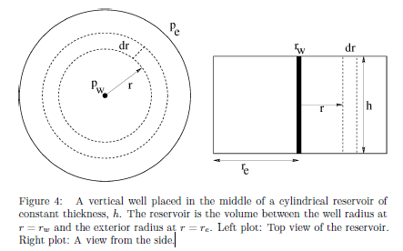

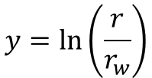
Governing Equation & Transformation
Radial diffusivity equation
Logarithmic coordinate transform
Simplifies operator to a constant-coefficient second derivative in y
$$\frac{δp}{δt}=η\frac{1}{r}\frac{δ}{δr}(r\frac{δp}{δr})$$
$$y=\ln\left(\frac{r}{r_{w}}\right)$$
Notes:
Task foundation:
The entire project builds on the radial diffusivity equation (hydraulic diffusivity)
Transformation:
To simplify the Partial Differential Equation, the project uses logarithmic coordinate which converts the radial operator into a constant-coefficient second derivative
Simplifies the discretization and improves numerical stability and accuracy!
Boundary conditions:
Inner boundary y=yw (specified flux)
Outer boundary y=ye (fixed pressure)

Slide 5
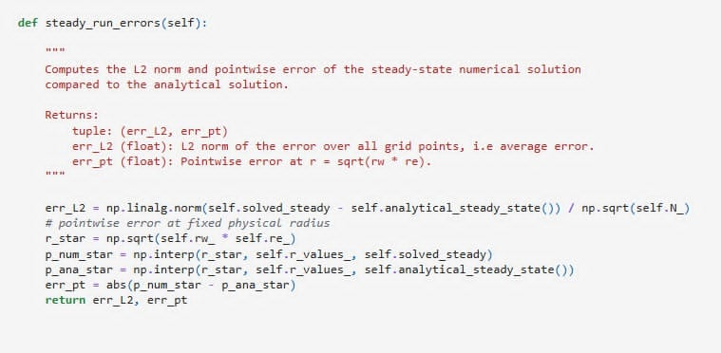

Ex 1: Steady State Solution
Analytical solution for steady-state pressure
$\frac{d_{p}^{2}}{d_{y}^{2}}=0 →p\left(y\right)=p_{init}+\text{α}(y−y_{e})$
Lazy vs not-so-lazy BC at $y−y_{e}$
  Lazy: $p_{N}=p_{e}\left(first order\right)$
  Not-so-lazy: Ghost extrapolation (second order)
Truncation and boundary errors
Notes:
Exercise objectives:
Derive analytical solution for steady-state pressure
Construct discrete time lazy BC with N = 4
Compute truncation error and boundary error order
Verify error scaling numerically
Theory:
Steady state implication
Lazy boundary condition (first order accuracy)
Not-so-lazy boundary, derived from Taylor expansion (second order accurate)
Implementation in our project:
Finite difference interior stencil, lazy and not-so-lazy boundary treatment in ‘PressureSolver’
Analytical solution used as reference
Limitations:
Only valid for constant properties and steady flow
Not-so-lazy still second order, but not exact for higher complexity problems

Slide 6
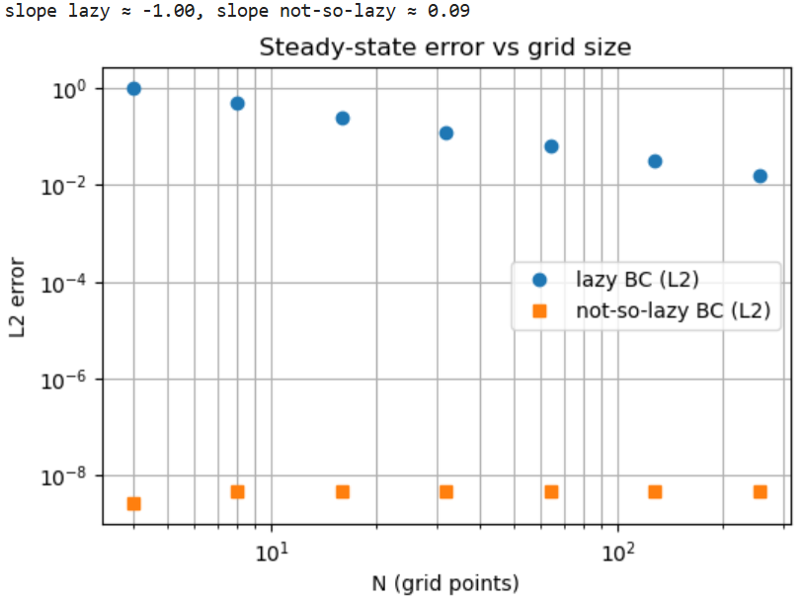

Steady State Error Behavior
Lazy BC -> $\text{O}\text{(}\text{Δ}\text{y}\text{)}$
Not-so-lazy BC -> $\text{O}\text{(}\text{Δ}\text{y}\text{^2}\text{)}$ (and exact for linear solution)
Convergence verified manually
Notes:
Exercise objective:
Quantify truncation error and verify error order numerically
Theory:
Interior truncation error
Lazy boundary domination (first order global error)
Not-so-lazy boundary eliminates this leading term
Implementations:
System solver for multiple N values
Error evaluated at fixed physical radius to ensure consistency
Results:
Lazy BC error slope ~-1 in log-log plot
Not-so-lazy bc slope ~0 (round-off limited – exact match!)
Confirms theoretical expectations

Slide 7
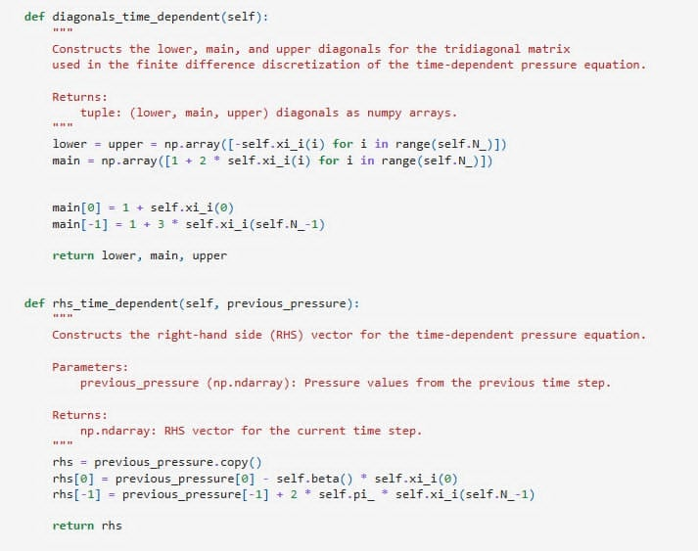
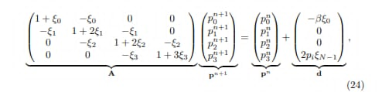

Ex 2: Implicit Transient Solver
Fully implicit time stepping of diffusivity equation
Discretization gives tridiagonal system per timestep
Matrix structure of N = 4
Advantages: Stable for large $\text{Δ}\text{t}$
Notes:
Exercise objectives:
Derivate matrix system for N=4
Show actual numerical matrix for given parameters
Implement a general simulator
Theory:
Implicit backward Euler (discretized)
Unconditionally stable and suitable for stiff problems
Implementation:
‘build_tridiagonal_matrix’ creates coefficient matrix
Solver supports multiple linear solution strategies
Results:
Matrix matches theoretical coefficients
Solver converges for any ∆t due to implicit scheme
Limitations:
First order in time
Early time accuracy depends on ∆t choice

Slide 8
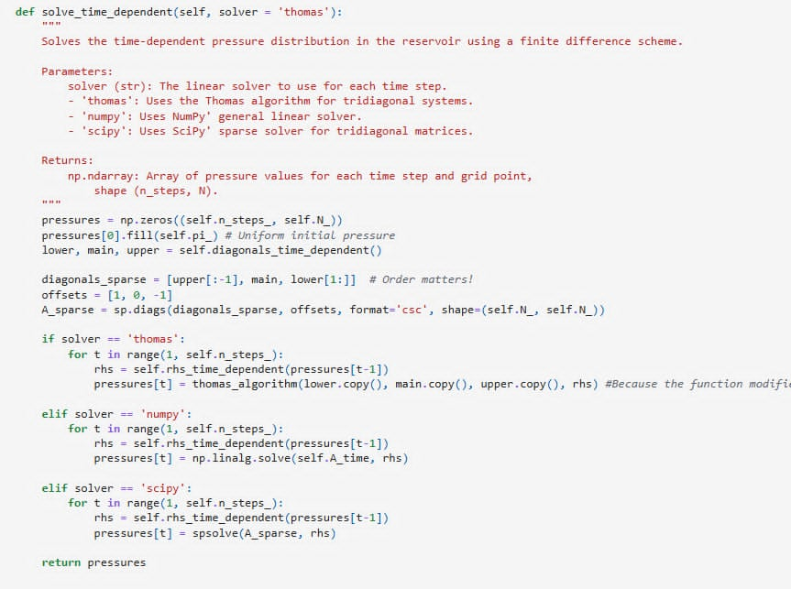
Implicit Transient Solver Code

Slide 9
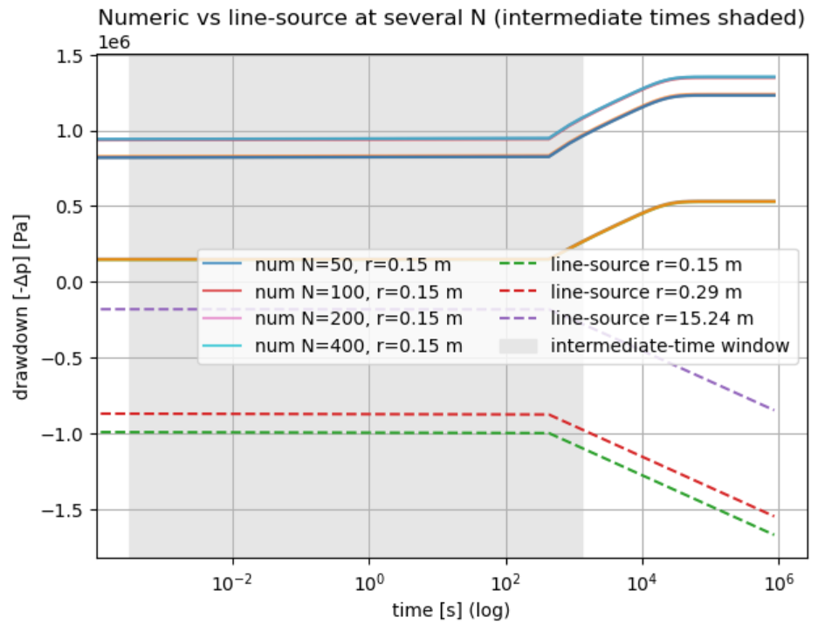
Ex 3: Comparison to Line-Source Solution
Numerical vs analytical
  Discretization effect at early times
  Excellent match at intermediate times
  Boundary effects at late times
Increasing N improves early/intermediate accuracy
Increasing grid resolution improves accuracy
Notes:
Exercise objective:
Compare numerical solution to analytical line-source solution (Theis) for transient flow
Theis represents infinite-acting reservoir
Theis is valid until pressure front reaches boundary
Time regimes:
Early times:
Pressure change is limited to near the wellbore (transient zone)
Intermediate times:
Reservoir behaves infinite-acting (semilog plot becomes linear – grey area on graph)
Late times:
Pressure disturbance reaches outer boundary r=re and behavior deviates from Theis curve
Results:
Numerical drawdown match the analytical Theis solution very well in the intermediate time region
At early times, the small deviations are caused by time discretization and startup effects
At late times, numerical curve flatten while analytical solution continues to decline
The Theis does not include boundaries
Grid refinement:
When increasing number of grid cells (N), match improves
Spatial convergence (finer discretization leads to lower numerical error)
Performance:
Three linear solvers
Dense (NumPy)
Sparse (SciPy)
Thomas algorithm
For small N, all perform similarly.
For large N, Thomas algorithm is the fastest – but we expected a bigger change from SciPy
Learning point:
Confirms solver accuracy and efficiency
Solvers behave as theory predicts in different flow regimes
Graph:
Shows pressure drawdown response over time for different grid sizes and radii
Drawdown (difference in pressure −Δp=pi​−p(r,t))
Intermediate time:
Numerical solution:
Constant slope
Analytical (Theis) solution:
Constant slope
Why
Pressure front is still inside reservoir (infinite-acting radial flow), so no change
Late time:
Numerical solution:
Curve bends upward and flatten out toward steady-state
Analytical (Theis) solution:
Declining at a faster rate for all radii
Why:
Numerical solution reaches the outer boundary re and approaches steady-state profile
Analytical assumes infinite reservoir, so will decrease infinitely

Slide 10
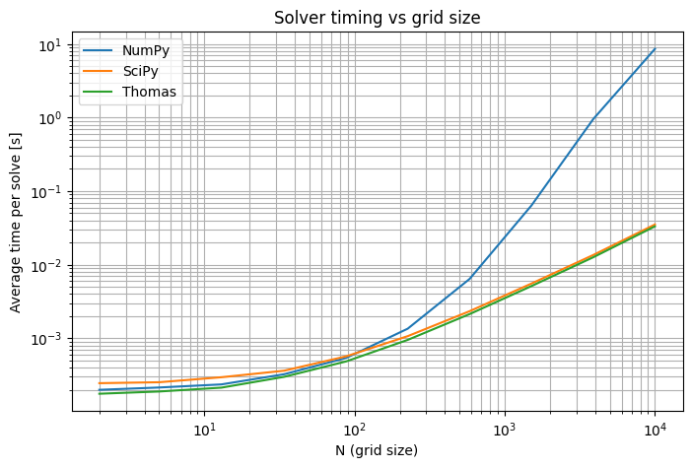
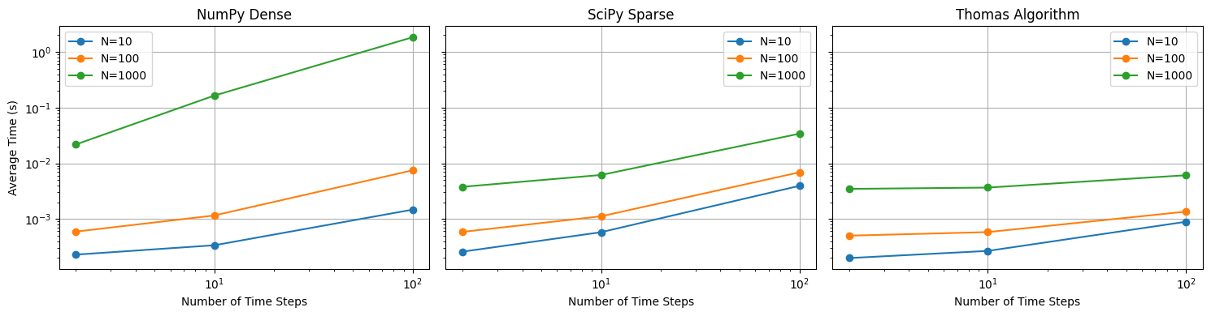
Solver Performance & Scaling
Solvers
  Dense (NumPy) -> Cubic scaling
  Sparse (SciPy) -> Better at mid range N
  Thomas algorithm -> Linear scaling, best overall
Notes:
Exercise objective:
Visualization of 3 solvers; dense (NumPy), sparse (SciPy) and Thomas algorithm
Implementation:
Timing across multiple N and timesteps
Logged average runtime
Results on graphs:
For small N, all methods similar (overhead dominates)
Around N~200, SciPy overtakes NumPy
Around N~200 Thomas is fastest
Consistent with theoretical complexity
Expected Thomas to be way faster than SciPy for large N

Slide 11
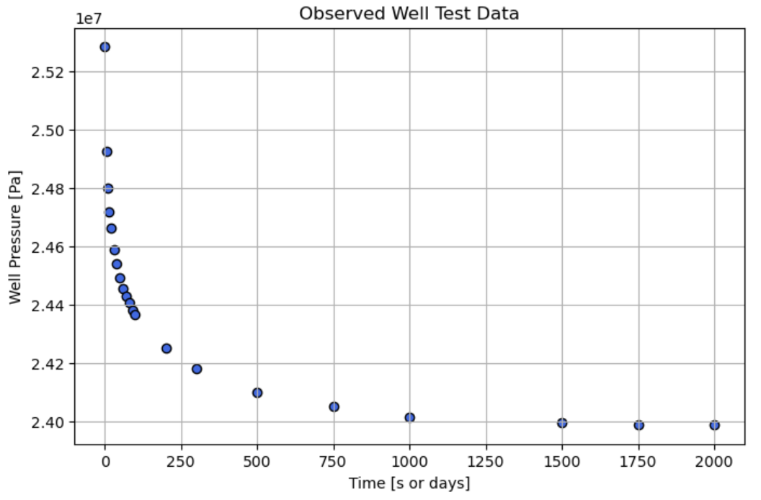

Ex 4: Well Test Matching
Observed well pressure data loaded from well_bhp.dat
Conversion to SI units
Scatter plot of well pressure vs time
Deriving a formula $p_{w}in terms of p_{0}$
Notes:
Exercise objective:
Load well test pressure data
Convert units to SI
Scatter plot of well pressure vs time
Derive formula for pw in terms of p0 (well block)
Theory:
Observed data shows early drawdown
Intermediate linear semilog region
Late time stabilization (boundary-dominated flow)
Neumann BC at well gives dp/dy = α
Taylor over half-cell gives pw ~p0 – Δy/2 * α
Implementation:
‘pandas’ for reading ‘well_bhp.dat’
Unit conversion psi -> SI
Scatter plot for inspection
‘well_pressure_from_block()’ computes for each timestep
Used for matching with well test data
Results:
Data aligns with expected pressure decline curve shape
Late-time plateau indicates boundary reached
Accurate approximation of well pressure for comparison with measurements

Slide 12
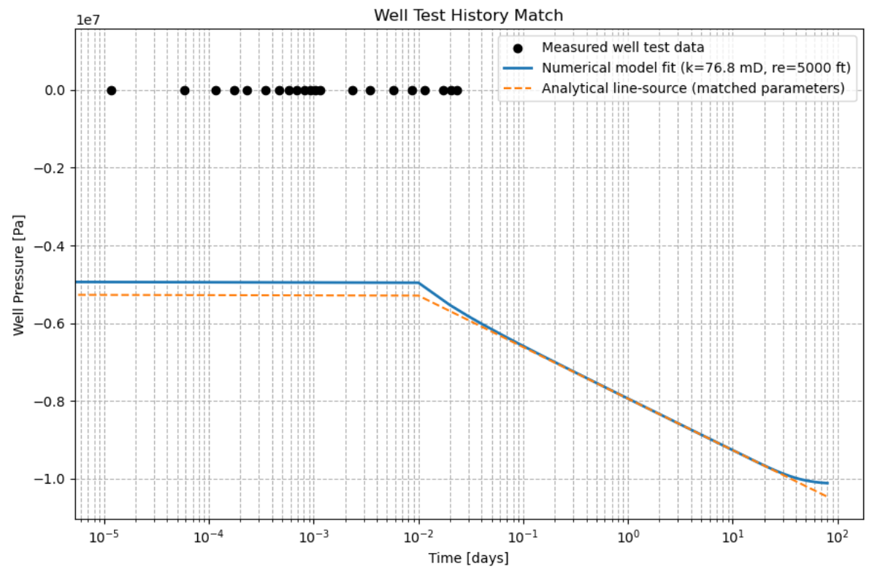

Matching Numerical Model to
Field Data
Parameter fitting $k, p_{i}, r_{e}$
Curve fit between measured data, numerical well pressure and Theis solution
Interpretation
  Early/intermediate match: Infinite acting
  Late plateau time: Boundary reached
  Line source keeps declining (no boundary)
Notes:
Exercise objective:
Fit parameters k, pi and re to data
Compare data, numerical solution, and Theis solution on log-time plot
Theory:
Parameter effects:
K; slope of semilog line
Pi; vertical offset
Re; late-time stabilization onset
Line-source keeps declining; numerical plateaus at boundary
Implementation
‘scipy.optimize.curve_fit’ to find best fit parameters
Simulated well pressure vs measured
Analytical theis computed with fitted parameters
Results:
Early/intermediate match is good for both line-source and numerical
Numerical curve levels off at late time (boundary felt)
Fitted parameters consistent with expected behavior)

Slide 13
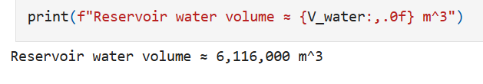
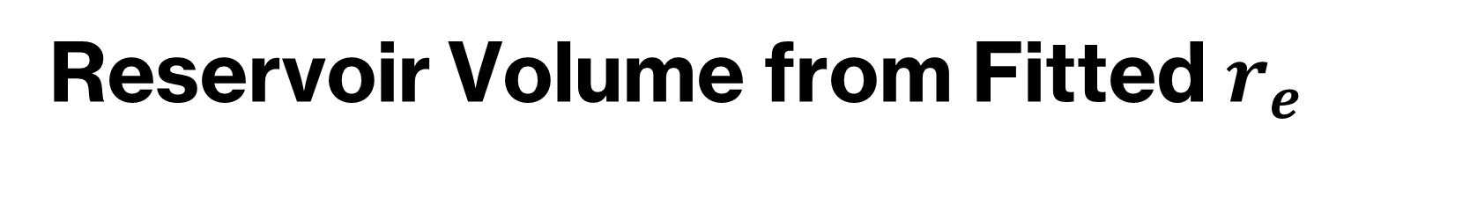

Reservoir Volume from Fitted $r_{e}$
$V_{w}=\text{ϕπ}\left(r_{e}^{2}−r_{w}^{2}\right)h$
Based fitting on $r_{e}$
Assumes homogenous porosity and water saturation = 1
Notes:
Exercise objective:
Calculate total water volume for fitted re
Theory:
V = ϕπ(re2​−rw2​)h
Assuming porosity ϕ (phi) and fully water saturated
Implementation:
Simple calculation using fitted re in SI units
Results:
Reservoir volume derived
Meaningful value consistent with late-time pressure
Assumes full saturation

Slide 14
Project Limitations and Alternatives
Assumptions
  Homogenous reservoir
  No skin or wellbore storage
  Fully implicit (1st order time)
Alternatives
  Higher order BC
  Pre factored sparse solver
  More complex boundary condition
Notes:
Homogenous reservoir: Reservoir does not change over time
No skin or wellbore storage: No fluid expansion in the wellbore (storage) and no near-wall damage/stimulation which will affect (skin)

Slide 15
Conclusions
Analytical solution and numerical solution are consistent
Boundary conditions control global accuracy
Implicit scheme is stable and flexible
Solver performance matches theoretical scaling
Well test data fitted successfully
Reservoir volume estimated from fitted parameters
Notes:
Overall:
Project integrates theory, numerical models and real data into a modeling workflow for radial flow in a reservoir
We see that theory and simulations are consistent
The project demonstrates accuracy and computational efficiency of chosen numerical method.
Exercise 1:
Analytical steady-state solution derived
We show how boundary condition choice affects error order
Lazy BC gives first order error
Not-so-lazy BC gives second order error
exact match to analytical solution
Exercise 2:
We built a robust implicit transient solver
We verify the stability and matrix structure
Exercise 3:
Numerical solution matches Theis in intermediate times and correctly deviates at late times when boundary is felt (as expected)
Solver timing confirm theoretical performance
Thomas algorithm offers best performance at large N
Although, expected better results/larger difference from SciPy
Exercise 4:
Real well test data successfully fitted for k, pi and re
Numerical model reproduces real well behavior including boundary effects at late times
Reservoir volume captured from fitted data

